Slide 1

Hello.
Flow Image Analytics
Agenda
Send in your pics for analysis
The Process
Demo the results

Slide 2





Ben Watt. At your service!
ben@datalineo.com
@benrebooted
linkedin.com/in/benonline
What I do:
Managing Director at Datalineo
Microsoft MVP Data Platform
Power BI: SQL/Azure/Power Platform
Dublin PUG leader
Event Co-Ordinator:
Data Ceili
Power Platform WT

Slide 3
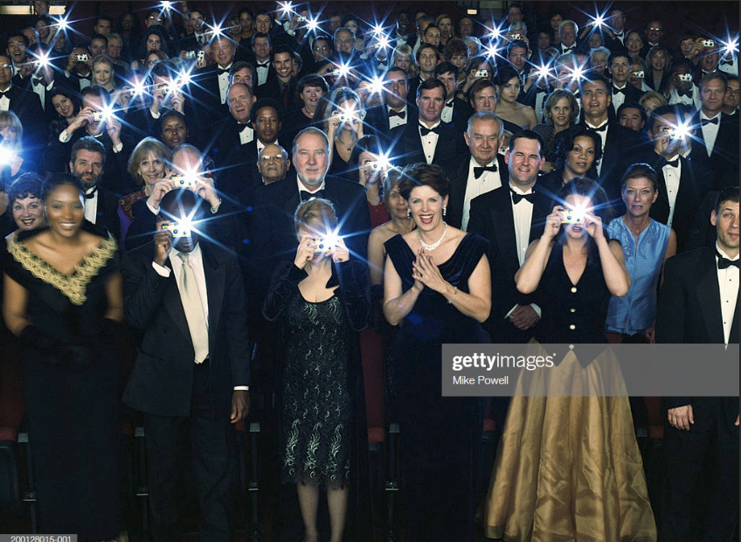
I need you!
Email hello@datalineo.com
Subject: FaceMe
Add some pictures to be analysed (as inline pics, not as attachment)
Selfies
You & Friend
Random objects
New Pics or from your Gallery
No photos or analysis data is retained
Will be removed TODAY
Prize on offer!

Slide 4













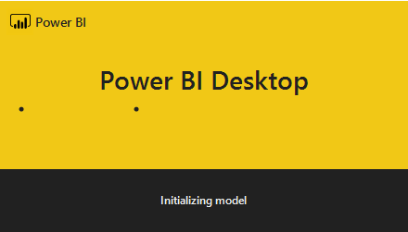
The Process
Trigger
Actions
Face API – Facial Attributes
Flow
For every attachment
Face API - Recognition
Store it in Azure Blob
Write to SQL
Email with images attached
Write to streaming dataset
Reply with Image Description(s)
Write to SQL
Computer Vision
Write to SQL
Power BI
Streaming Dashboard
Image Analytics Report

Slide 5

Thank you!
ben@datalineo.com
@benrebooted
linkedin.com/in/benonline
Slides, etc:
https://github.com/datalineo/sessions/EvolvePowerBIArchitecture

